Slide 1
Model Predictive Control based approach to Trajectory Optimization for Autonomous Underwater Vehicles
Thesis presentation by Sarthak Mishra, IISER Bhopal.
Supervisor: Prof. Joao Bourges de Sousa, University of Porto, Portugal.
Co-supervisor: Dr. Sunil Pratap Singh, Department of Physics, IISER Bhopal.

Slide 2
THEORY

Slide 3

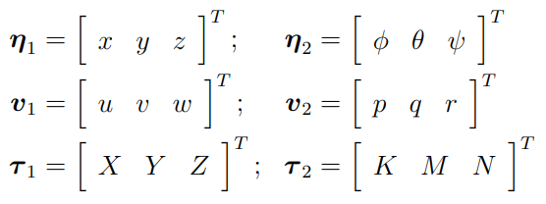
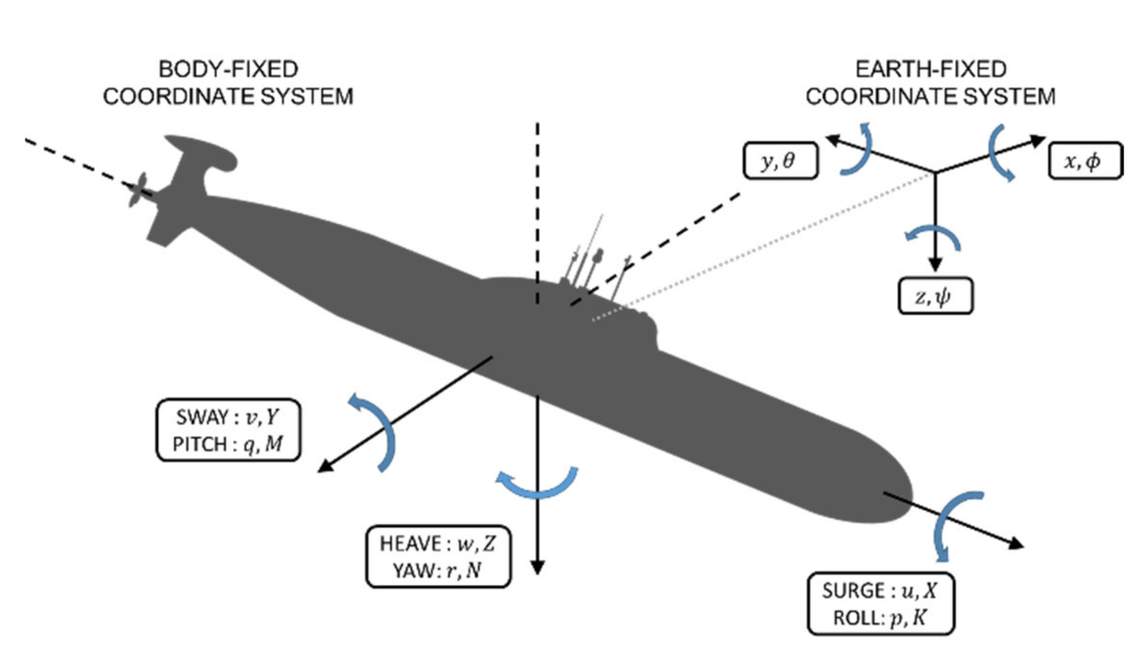
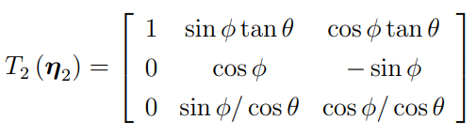
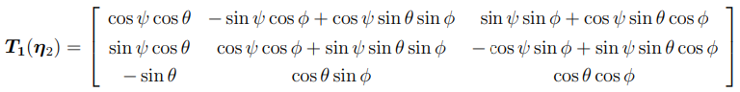
BASIC TOOLS
North-East-Down (NED) Frame of Reference
Image credits: Smcspo-based robust control of AUV in underwater environments including disturbances by Hyun-Hee Kim, Min Cheol Lee, Hyeon-Jin Cho, Jun-Ho Hwang, and Jong-Seob Won.
Position and Velocity Vectors
Transformation Matrix for Rotation
Transformation Matrix for Translation
Notes:
T1 = transformation matrix for translational velocities; T2 = for rotational velocities.

Slide 4
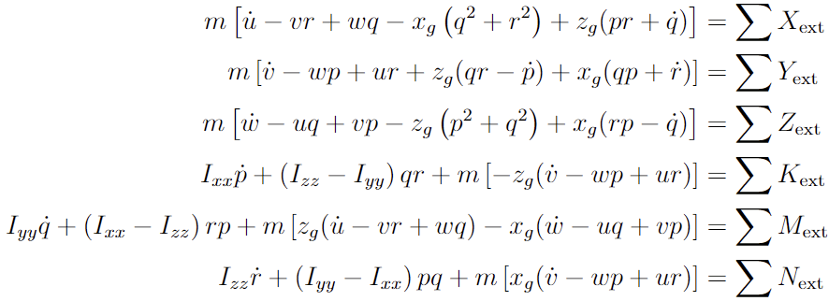
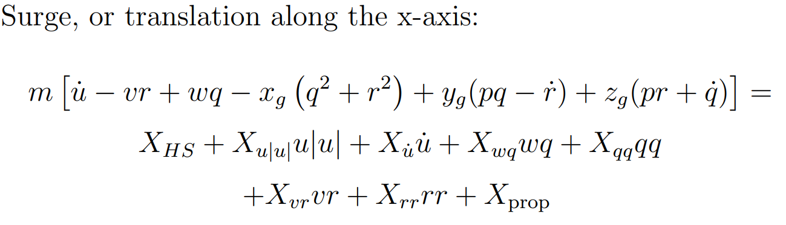
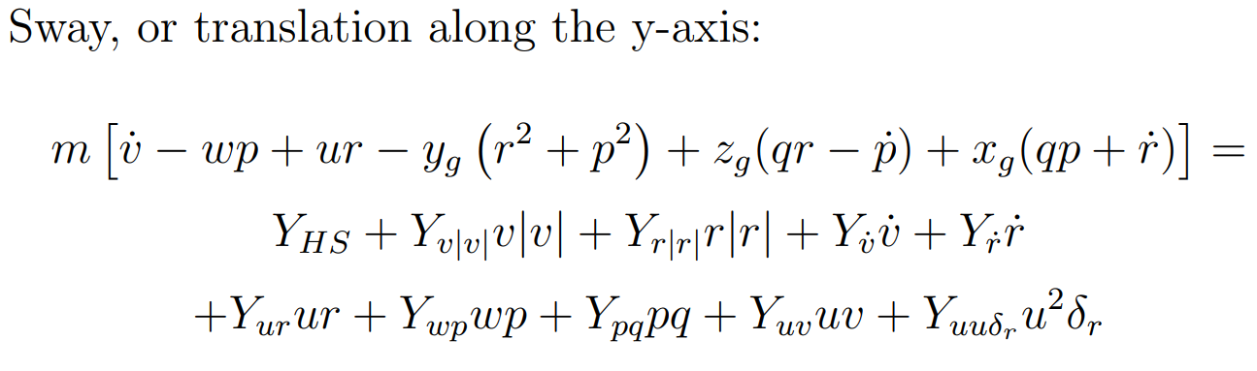
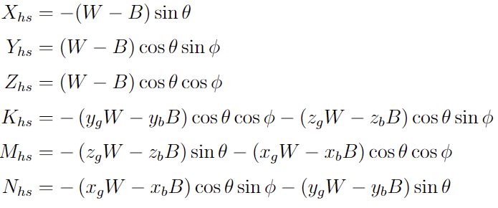

IDEAL 6 DOF Equations
Combined Nonlinear 6 DOF Equations
In all other six degrees of freedom.

Slide 5
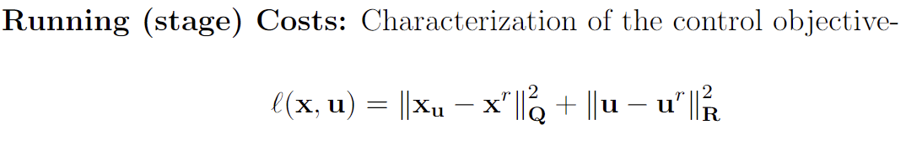
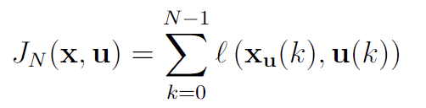
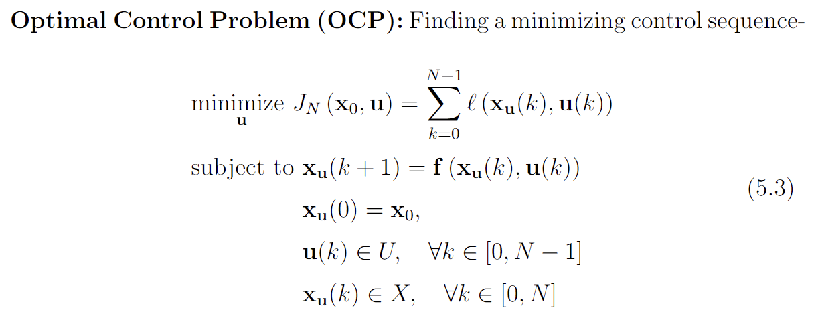
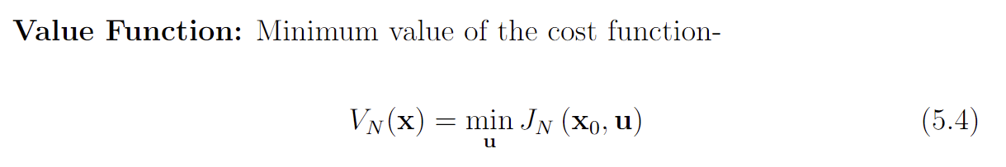

MODEL PREDICTIVE CONTROL
Running (stage) Costs: Characterization of the control objective-
Cost Function: Evaluation of the running costs along the whole prediction-
Optimal Control Problem (OCP): Finding a minimizing control sequence-
Value Function: Minimum value of the cost function-

Slide 6
IMPLEMENTATION ON A 2D VEHICLE

Slide 7
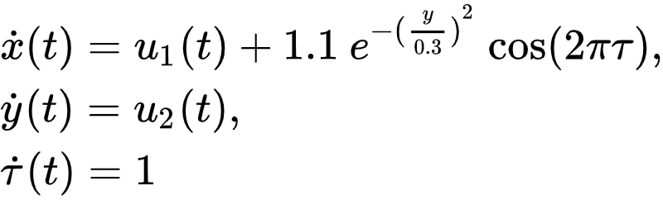
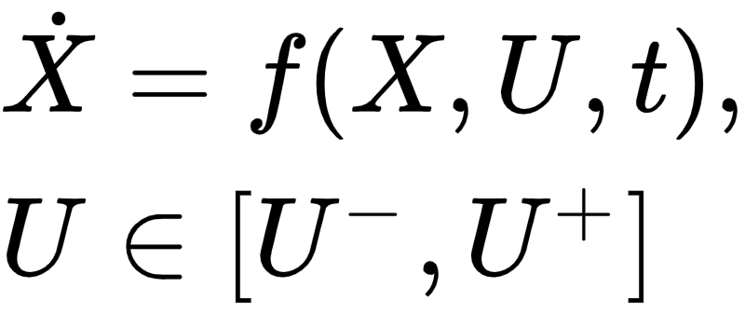
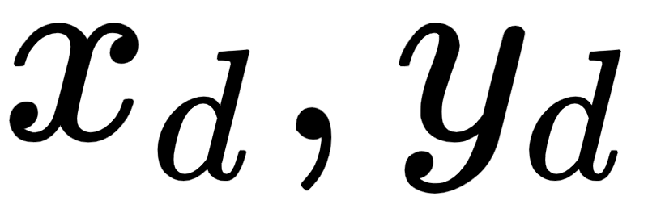

Problem Setup- 2D AUTONOMOUS Vehicle
Kinematic model of a point-based AUV
Cost function for the MPC
Subject to:
where is the prediction horizon, and are the
destination coordinates.

Slide 8
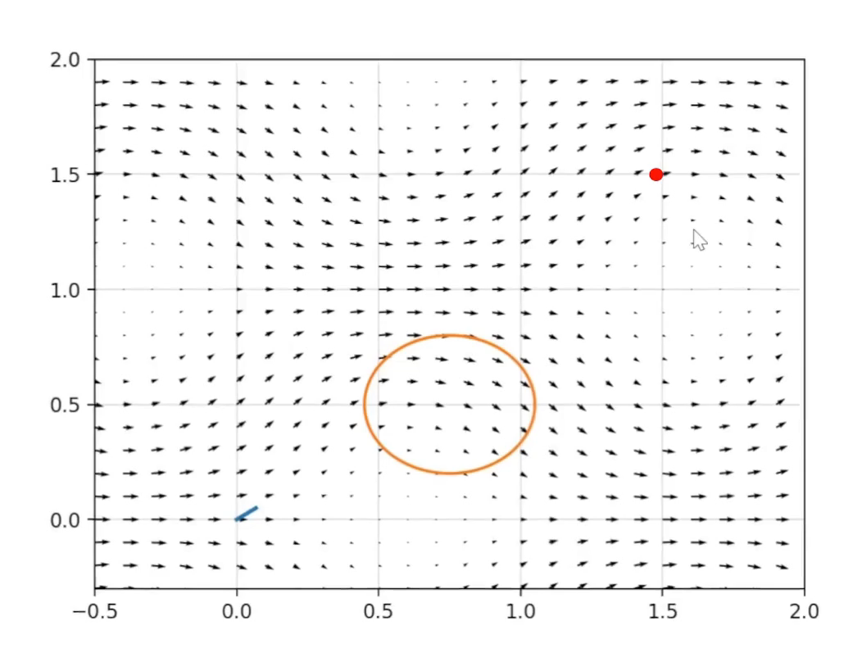
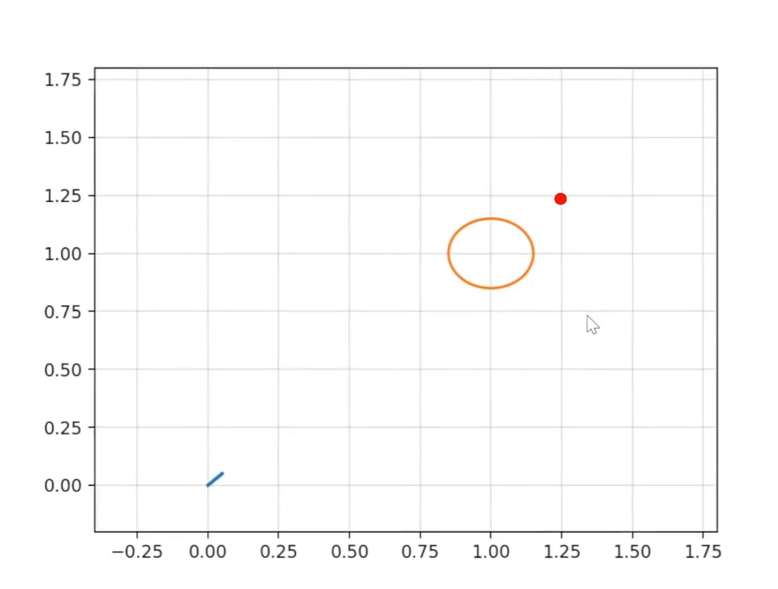
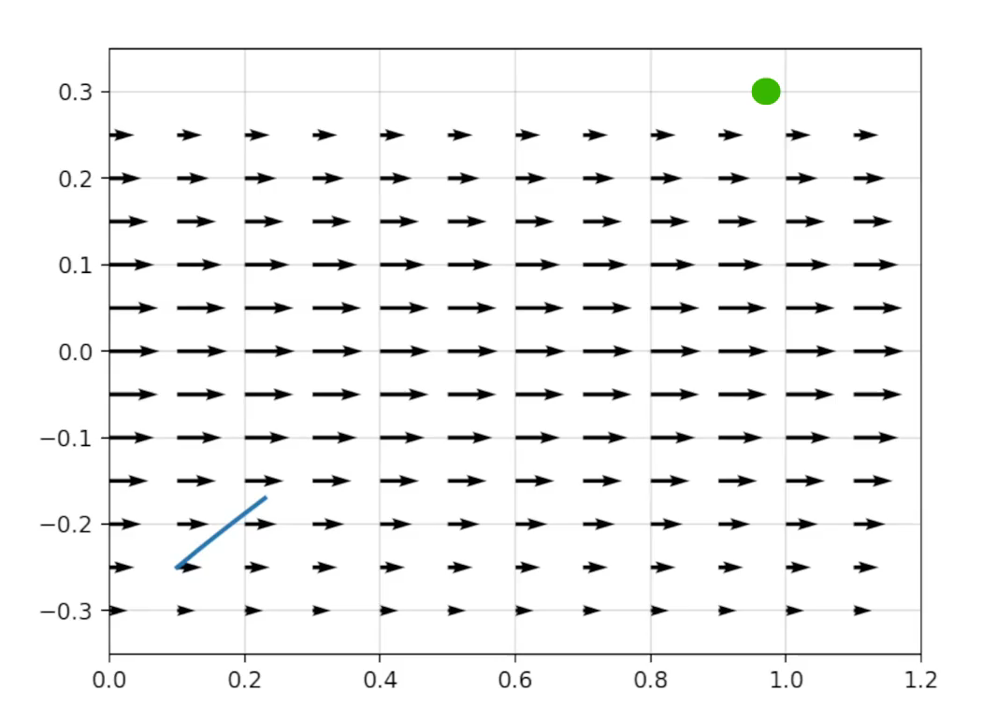
RESULTS ON A 2D AUTONOMOUS VEHICLE
TRAJECTORY OPTIMIZATION ON A TIME VARYING FLOW FIELD
Obstacle Avoidance
Path Planning
Model Predictive Control based approach to Trajectory Optimization for Autonomous Underwater Vehicles
10/04/2023

Slide 9
IMPLEMENTATION ON A 6 DOF AUV

Slide 10
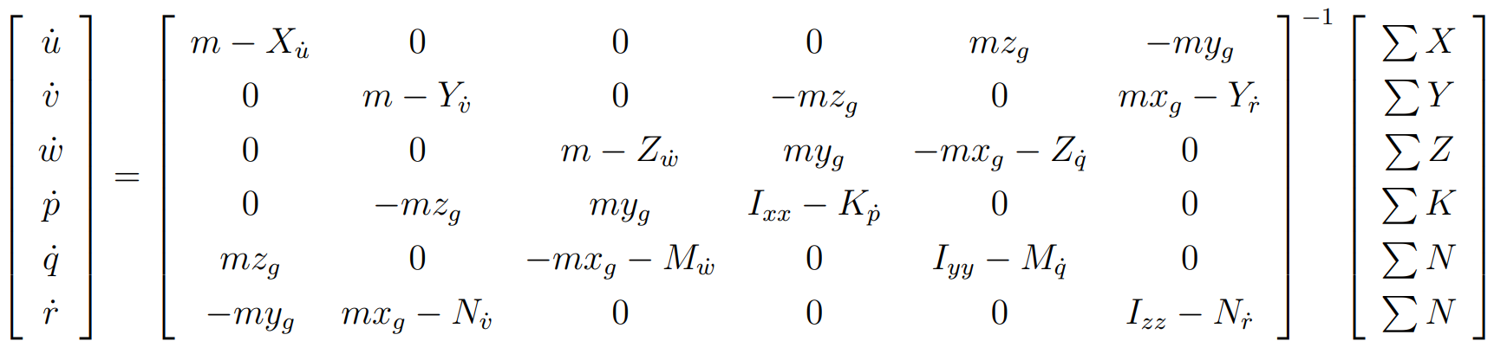
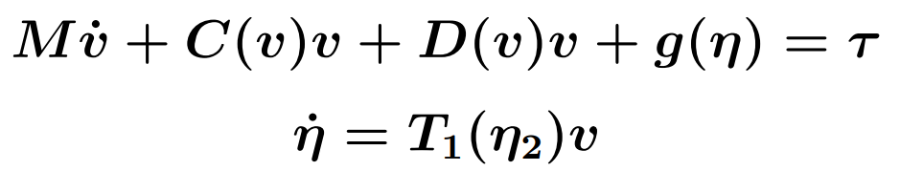
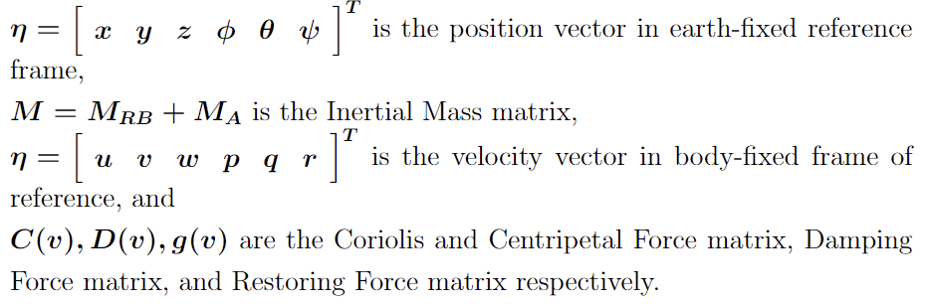
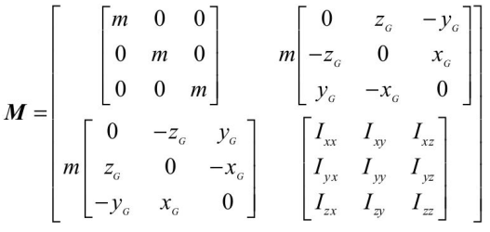
6 DOF EQUATIONS FOR REMUS 100

Slide 11
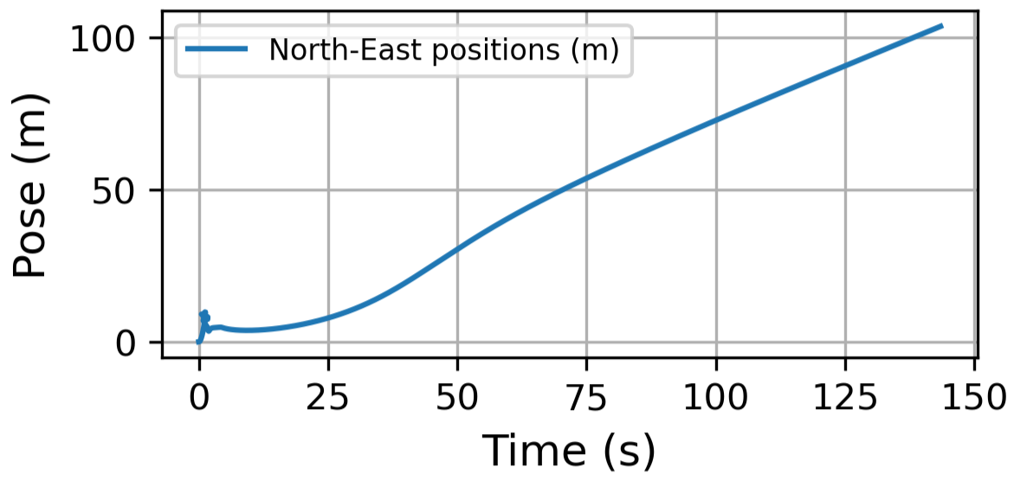
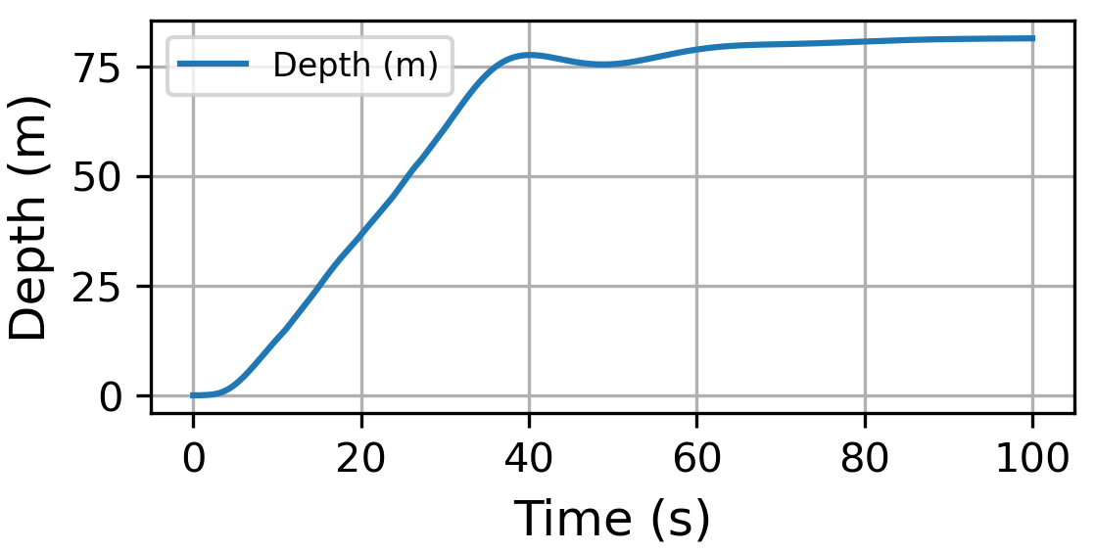
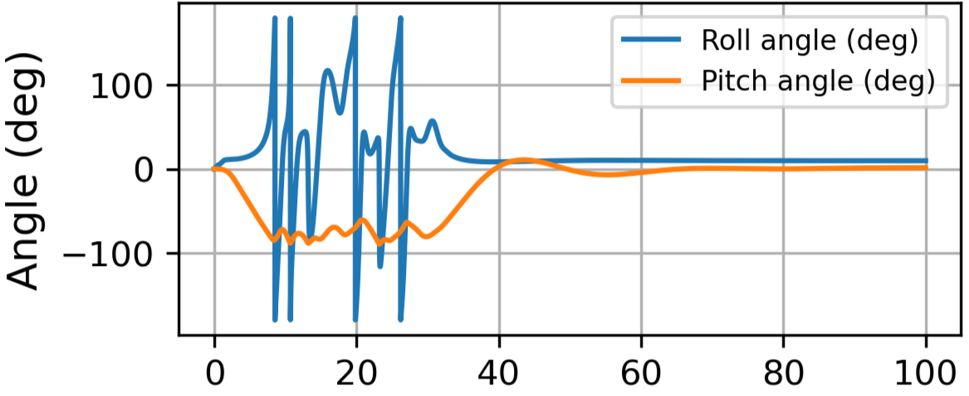
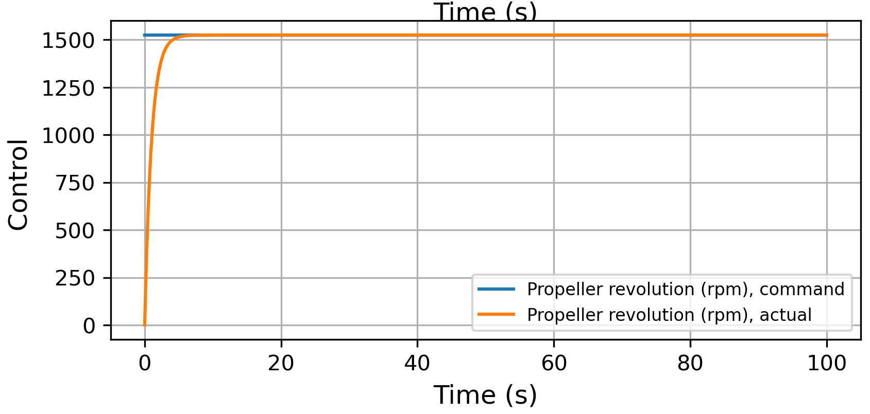
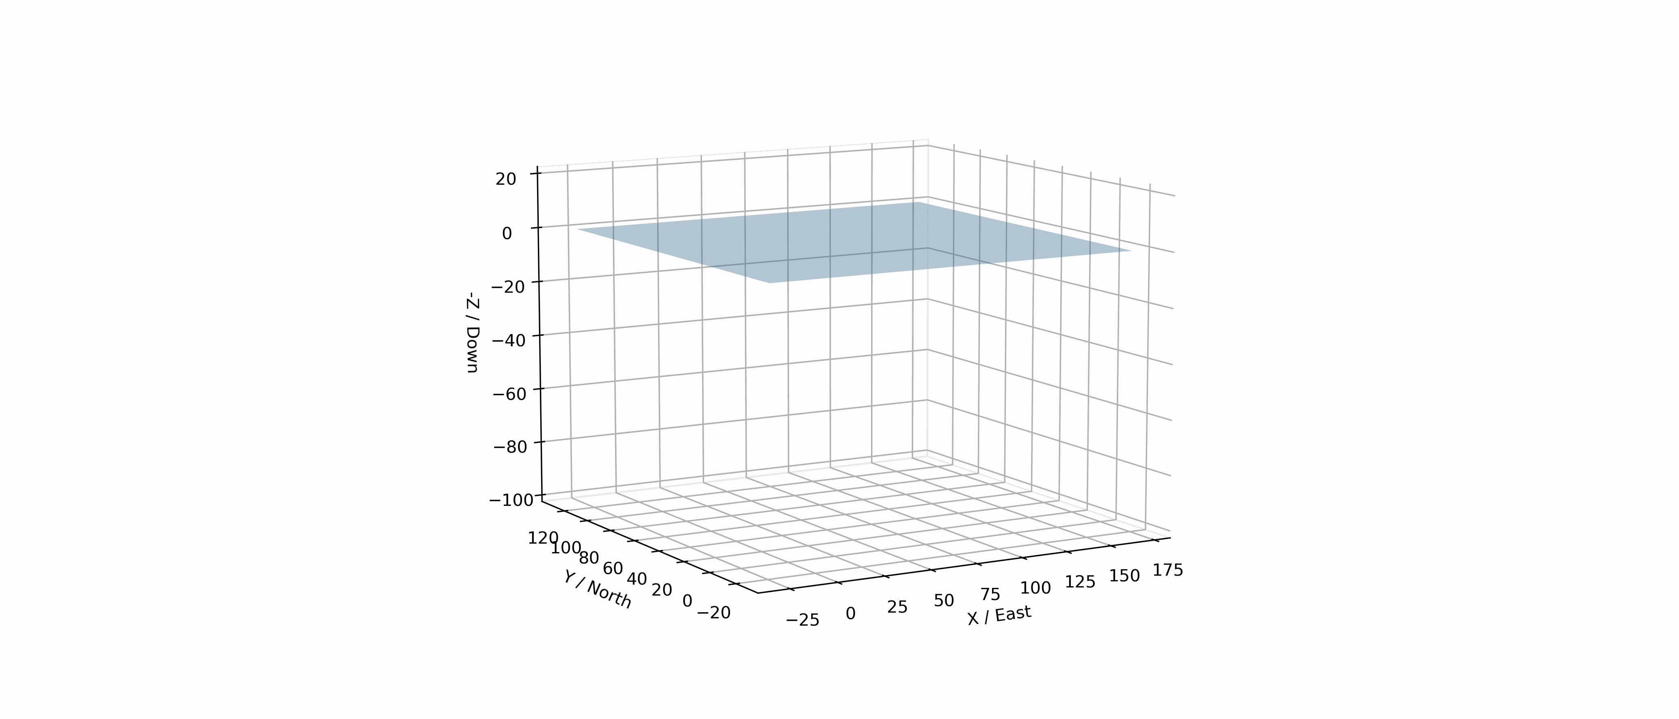
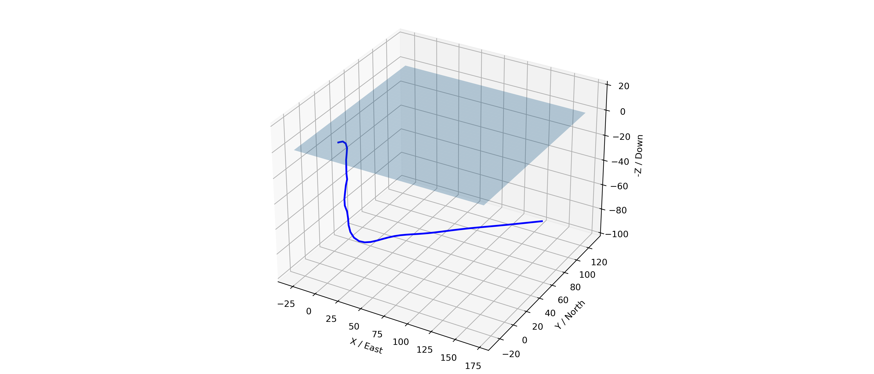
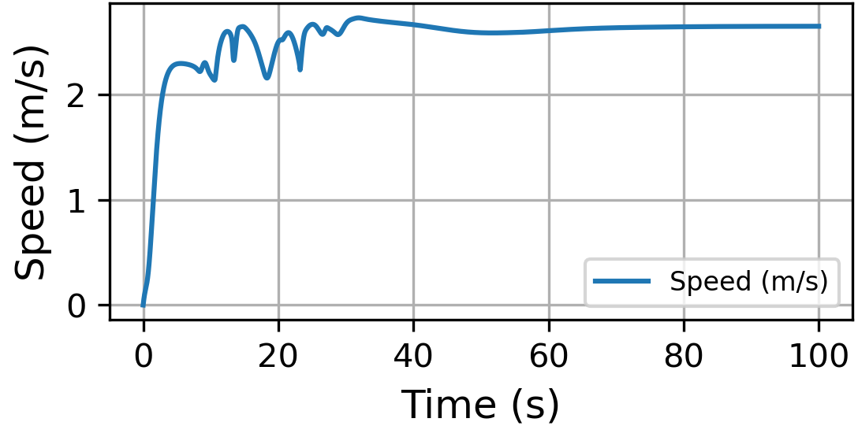
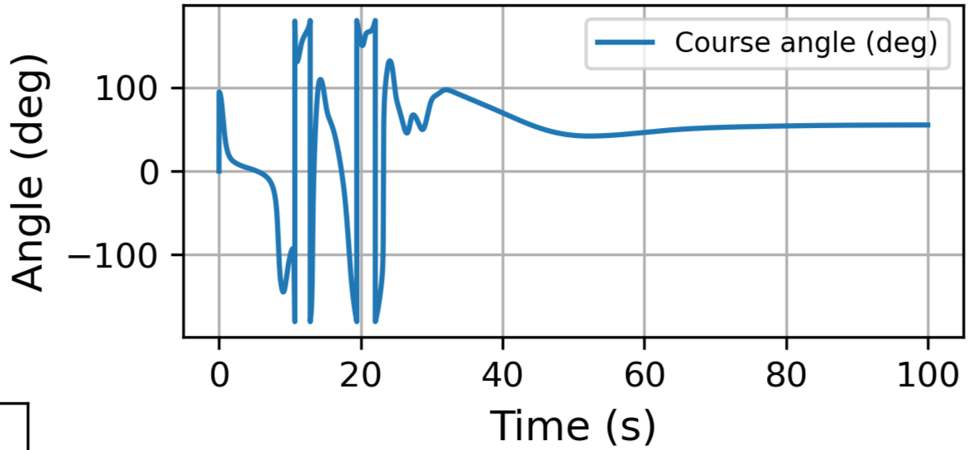
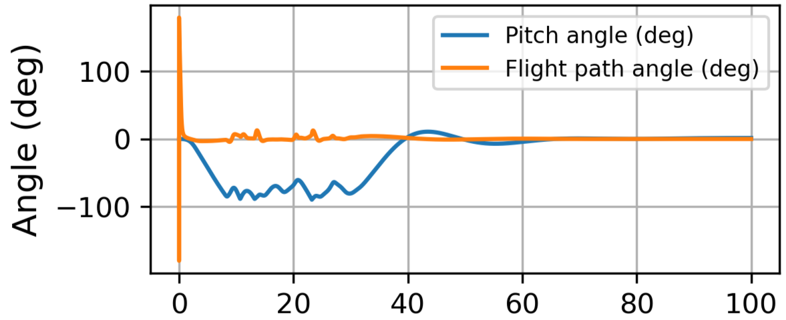
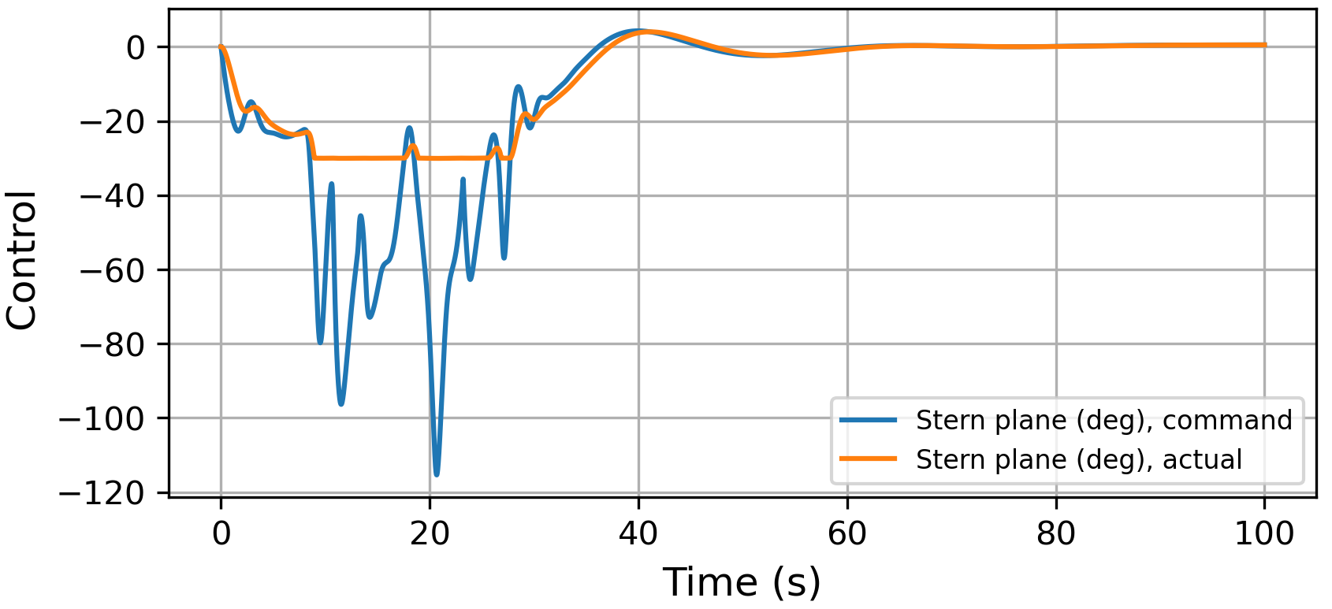
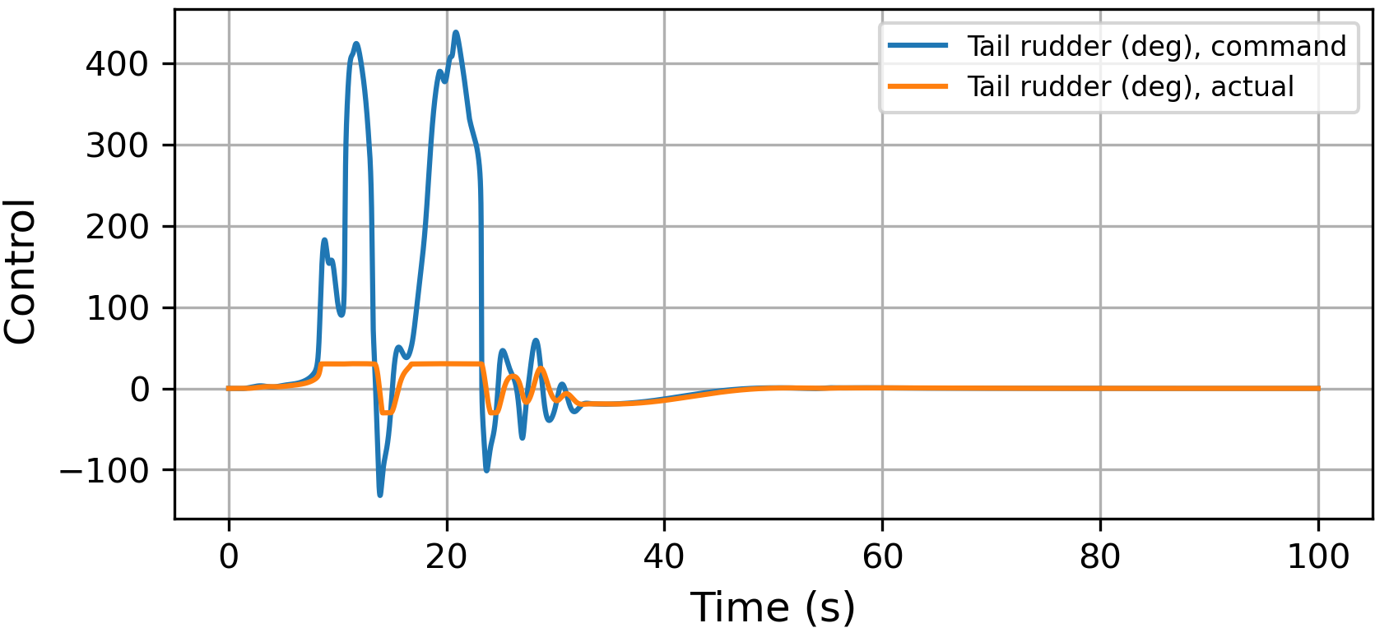
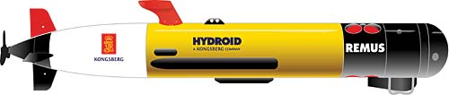
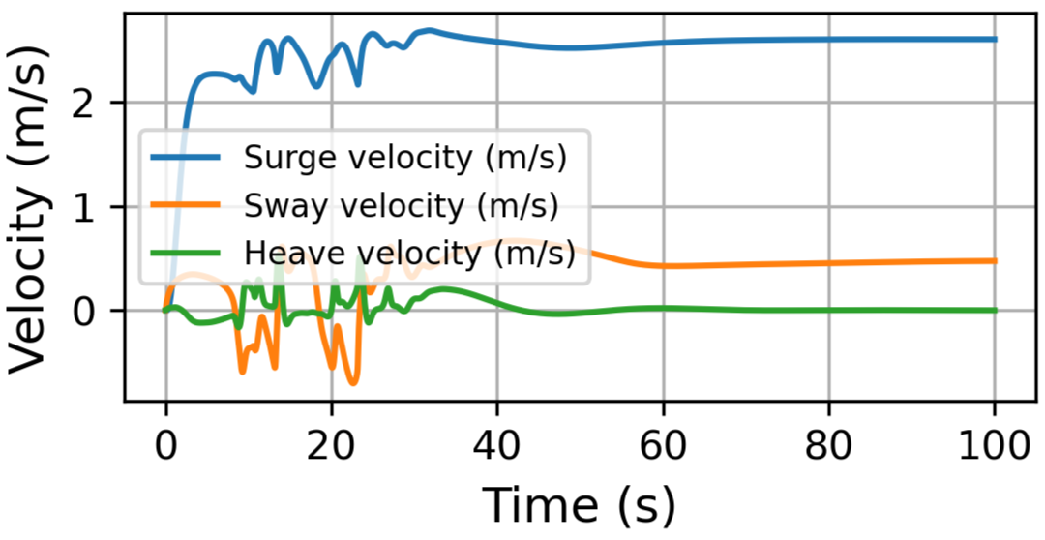
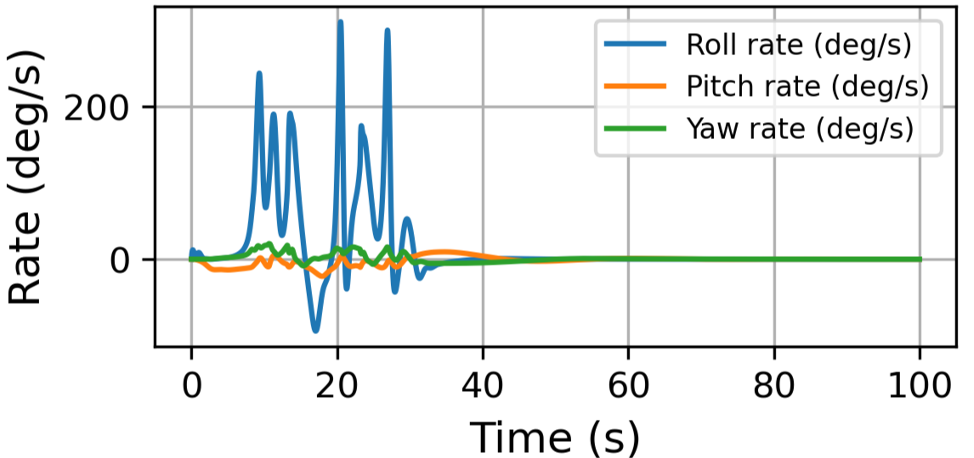
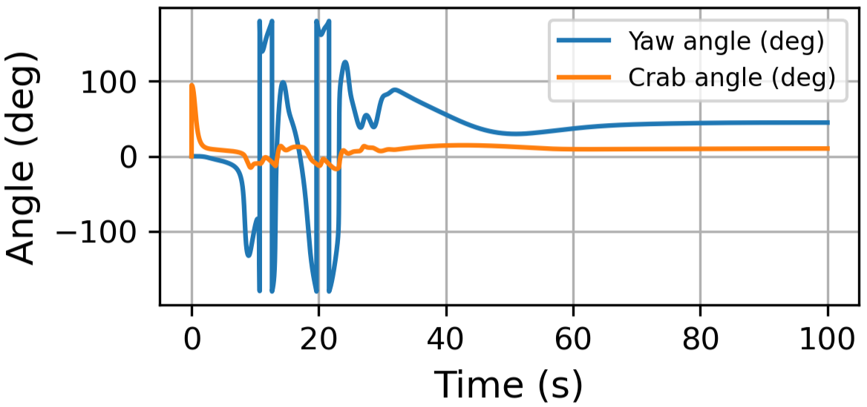
Numerical Simulation
VEHICLE STATES OUTPUT
VEHICLE CONTROL OUTPUT
TRAJECTORY OPTIMIZATION OF A 6 DOF AUV
Simulation Parameters:
t: time steps - 0.001
N: sample time - 100000
d: desired depth, positive downwards (m) - 80
psi_d: desired heading angle (deg) - 40
n_d: desired propeller revolution (rpm) - 1525
V_c: current speed (m/s) - 0.5
beta_c: current direction (deg) - 120
The REMUS 100 AUV
Model Predictive Control based approach to Trajectory Optimization for Autonomous Underwater Vehicles
10/04/2023
Model Predictive Control based approach to Trajectory Optimization for Autonomous Underwater Vehicles
10/04/2023
Model Predictive Control based approach to Trajectory Optimization for Autonomous Underwater Vehicles
10/04/2023

Slide 12
REFERENCES
T. I. Fossen (2021). Handbook of Marine Craft Hydrodynamics and Motion Control. 2nd. Edition, Wiley.
Fossen, T. I. (2020). Python for Underwater and Marine Systems Modeling, Control, and Simulation (1st ed.). John Wiley & Sons link
Verification of a six-degree of freedom simulation model for the REMUS autonomous underwater vehicle by Timothy Prestero, MIT.
Dynamics and control of marine robotic vehicles by A. J. Healey, Naval Postgraduate School, California.
Workshop on Optimization based Solutions for Control and State Estimation in Dynamical Systems (Implementation to Mobile Robots) by Mohamed W. Mehrez.
Miguel Aguiar, João Borges de Sousa, João Miguel Dias, Jorge Estrela da Silva, Renato Mendes and Américo S. Ribeiro, ”Trajectory Optimization for Underwater Vehicles in Time-Varying Ocean Flows”, IEEE/OES Autonomous Underwater Vehicle Workshop (AUV), 2018 link
THANK YOU!

